Slide 1
Dlaczego teraz?
Ewolucja AI
Krzysztof Joachimiak

Slide 2
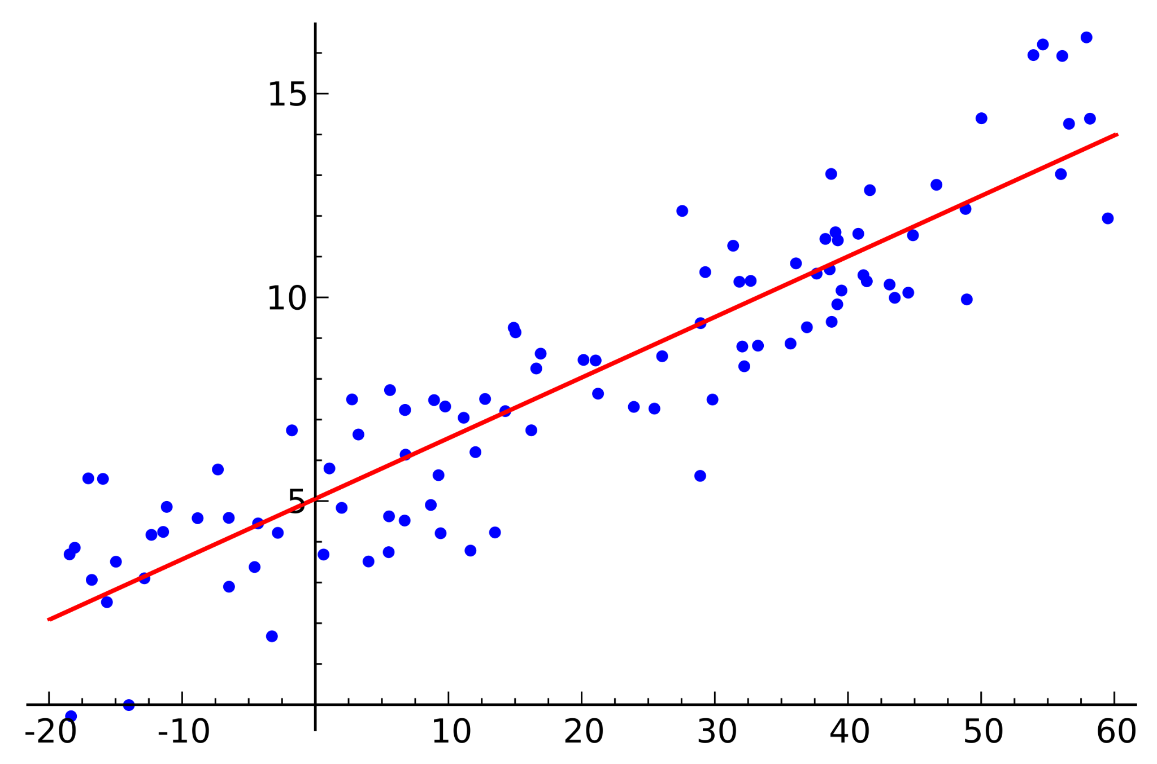
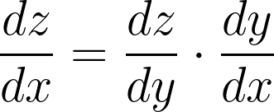
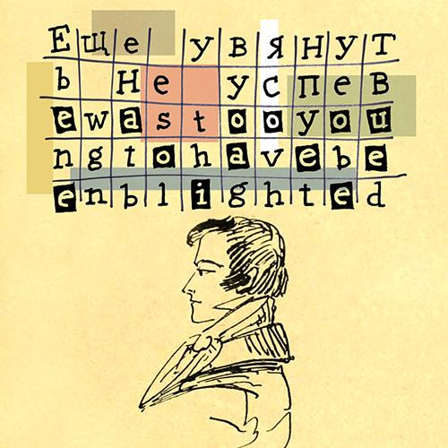
Zanim powstały komputery
1676
Reguła łańcuchowa
1795-1805
Model liniowy
1913
Samogłoska czy spółgłoska? (A. Markow)
Źródło:
https://paperswithcode.com/method/linear-regression
Notes:
Prekursorzy tłumaczenia automatycznego - patrz: https://aclanthology.org/www.mt-archive.info/IJT-2004-Hutchins.pdf https://www.scribd.com/document/99135923/Course-Paper-on-Machine-Translation
Wczesna historia AI https://en.wikipedia.org/wiki/Timeline_of_artificial_intelligence https://en.wikipedia.org/wiki/History_of_artificial_intelligence
Markow https://www.americanscientist.org/article/first-links-in-the-markov-chain https://www.math.purdue.edu/~yipn/talks/108-MarkovChain-Fall2019.pdf
http://www.alpha60.de/research/markov/DavidLink_AnExampleOfStatistical_MarkovTrans_2007.pdf

Slide 3
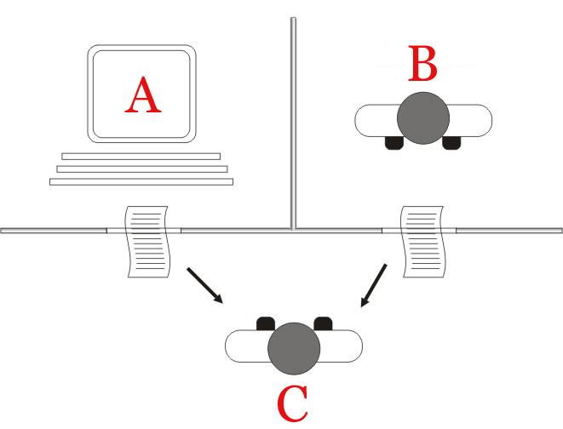
Test Turinga (1950)
Prowadzimy rozmowę z człowiekiem i maszyną próbując zgadnąć, który z rozmówców jest maszyną.
Notes:
https://botland.com.pl/blog/test-turinga-zdany-naukowcy-nie-sa-zgodni-czym-w-ogole-jest/#Z-zastrzezeniem-ze

Slide 4
Ewolucja AI
Good old-fashioned AI
Symboliczne AI
Glass box
Wyspecjalizowanie modele
Machine Learning
Deep Learning
Black box
Multimodal AI
Artificial General Intelligence
1960
2020
Notes:
AGI: https://www.deepmind.com/publications/a-generalist-agent

Slide 5
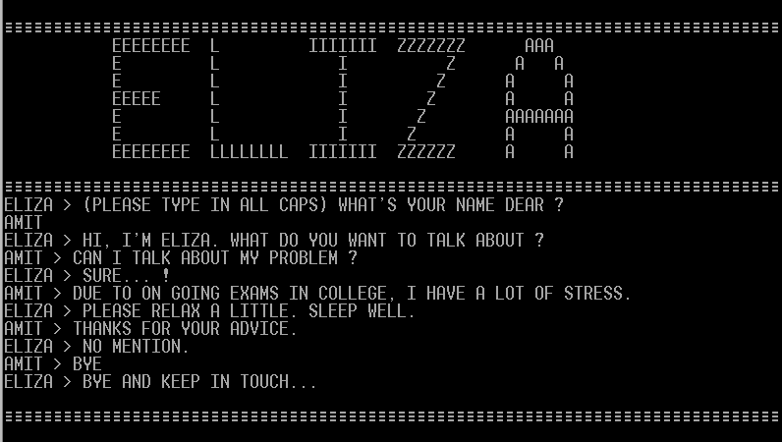
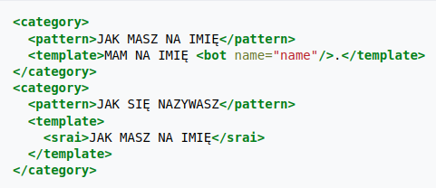
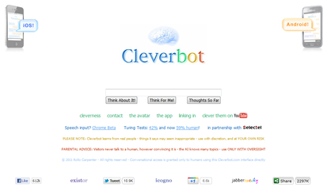
Chatboty
1966
ELIZA
1995 AIML
1997 Cleverbot
Notes:
https://www.existor.com/products/cleverbot-data-for-machine-learning/
https://summalinguae.com/language-technology/rule-based-machine-translation-vs-statistical-and-neural-machine-translation/

Slide 6
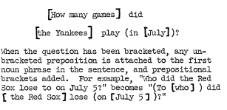
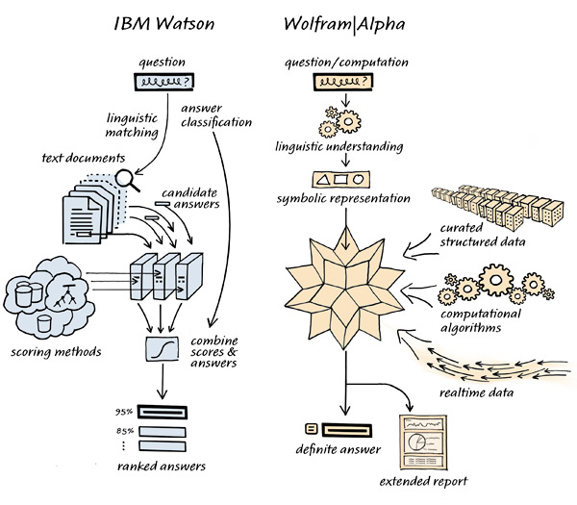
Question Answering
2008-2011 Wolfram Alpha IBM Watson
1961
BASEBALL
Notes:
https://dl.acm.org/doi/pdf/10.1145/1460690.1460714
https://web.stanford.edu/~jurafsky/slp3/old_oct19/25.pdf
Critics say IBM executives overshot badly by allowing marketing messages to suggest that Watson’s Jeopardy! breakthrough meant it could break through on just about anything else. “The original system was a terrific achievement, there’s no question about that,” says Oren Etzioni, CEO of the Allen Institute for AI. “But they’ve really over-claimed what they can deliver in a big way; the only intelligent thing about Watson is their PR department.”
https://www.wired.com/story/ibm-watson-won-jeopardy-but-is-it-smart-enough-to-spin-big-blues-ai-into-green/
https://stanford.edu/~cpiech/cs221/apps/watson.html
https://researcher.watson.ibm.com/researcher/view_group_subpage.php?id=2159
https://plato.stanford.edu/entries/artificial-intelligence/watson.html
https://writings.stephenwolfram.com/2023/01/wolframalpha-as-the-way-to-bring-computational-knowledge-superpowers-to-chatgpt/
https://www.quora.com/Whats-the-system-architecture-of-the-IBM-Watson

Slide 7
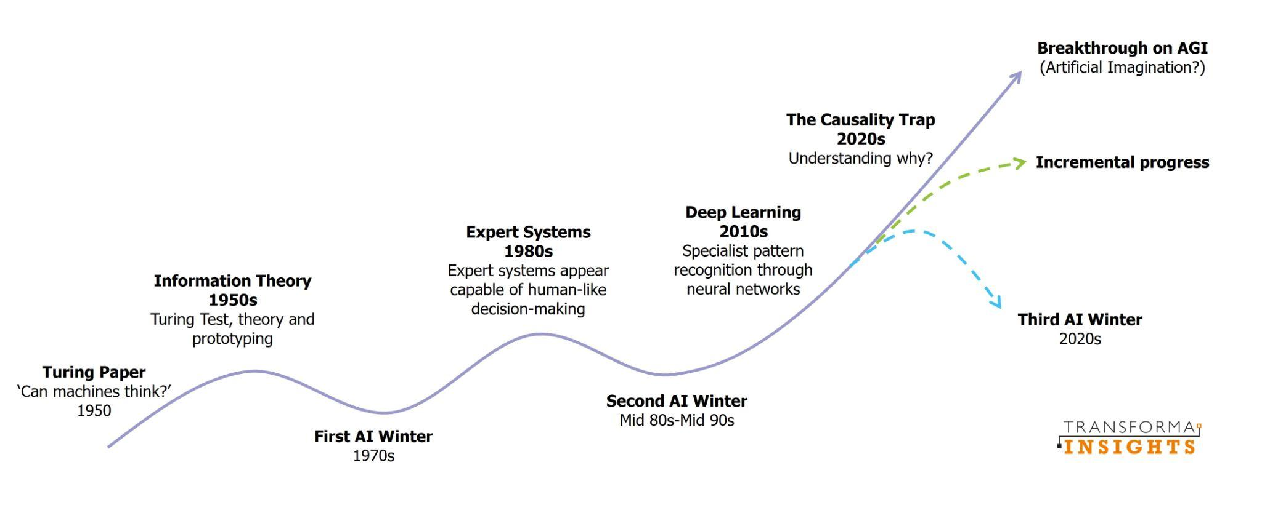
Zimy sztucznej inteligencji
1966
“Summer vision project”
1987-1992
Japonia i USA: spadek inwestycji rządowych w AI
1971-75
DARPA - fiasko projektów
Notes:
https://en.wikipedia.org/wiki/AI_winter
https://timeline.historyofdatascience.com
https://en.wikipedia.org/wiki/Symbolic_artificial_intelligence
https://www.historyofdatascience.com/ai-winter-the-highs-and-lows-of-artificial-intelligence/
https://www.linkedin.com/pulse/chatgpt-trigger-next-aiwinter-jason-bell/
https://medium.com/@keesgroeneveld/why-the-next-ai-winter-will-not-happen-10bc47cda22c
https://dspace.mit.edu/handle/1721.1/6125

Slide 8
“(Jack) Schwartz believed that DARPA was using a swimming model—setting a goal, and paddling toward it regardless of currents or storms. DARPA should instead be using a surfer model— waiting for the big wave, which would allow its relatively modest funds to surf gracefully and successfully toward that same goal.”
— Machines Who Think, Pamela McCorduck
Notes:
https://monoskop.org/images/1/1e/McCorduck_Pamela_Machines_Who_Think_2nd_ed.pdf

Slide 9
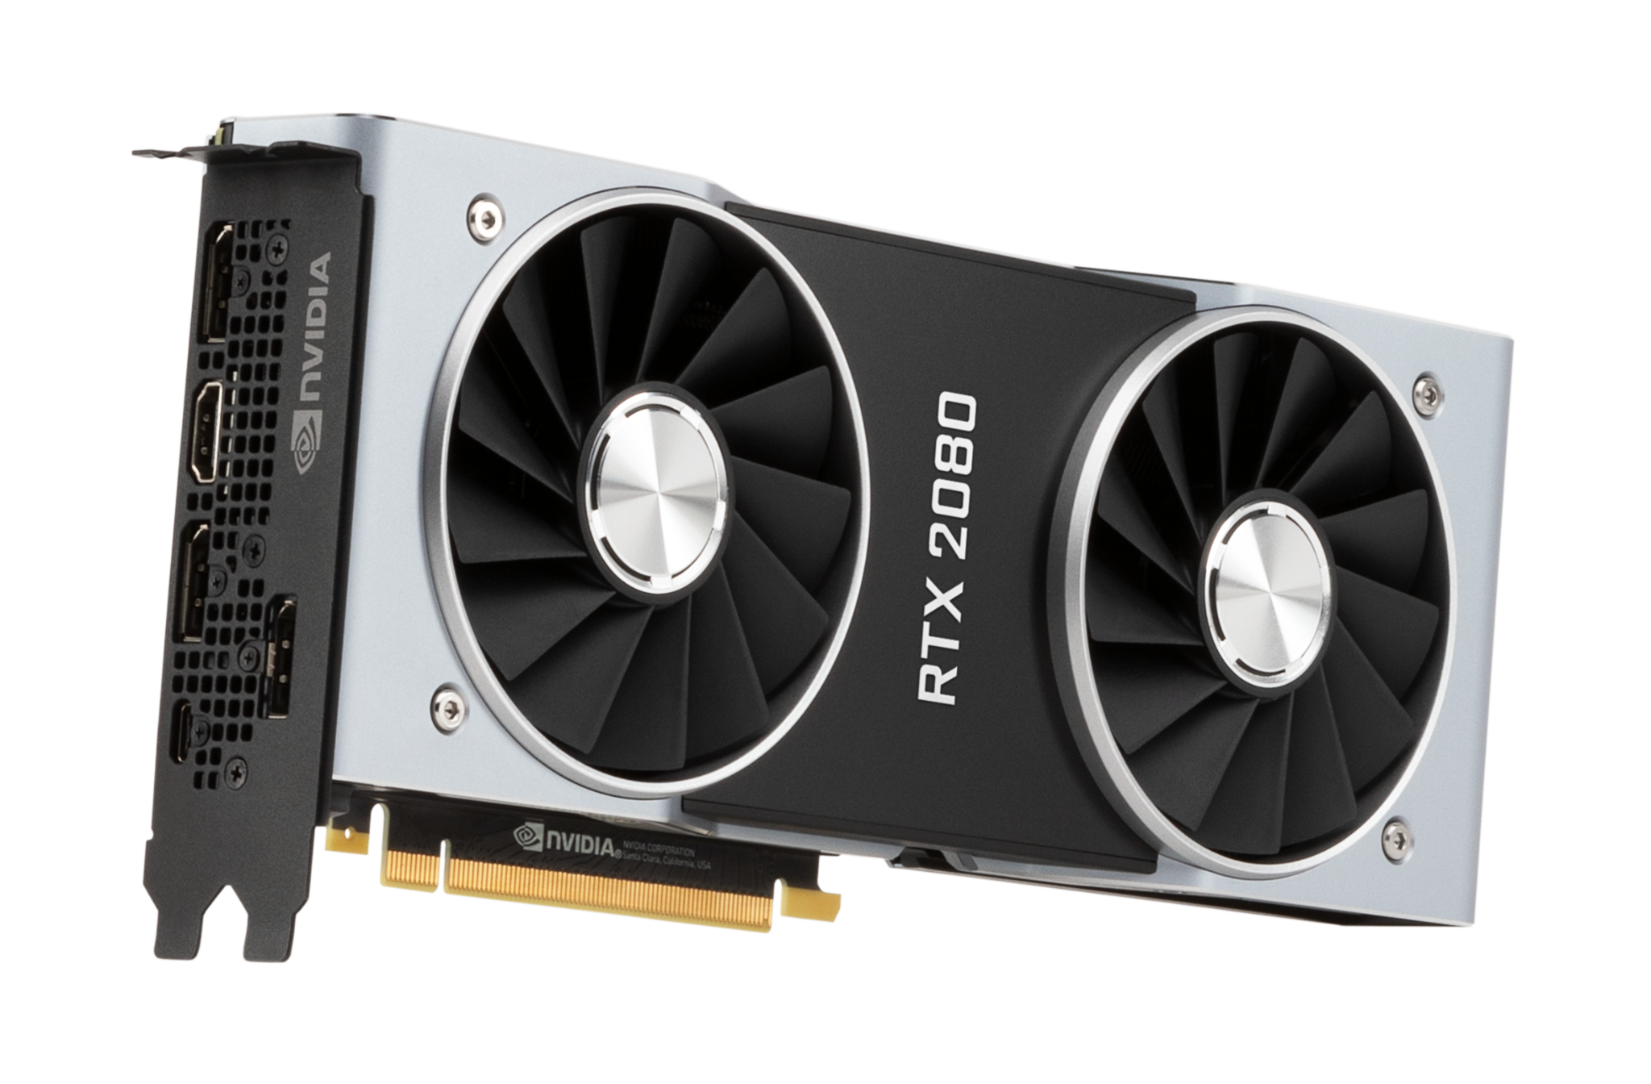
Czynniki wzrostu (lata 90 - teraz)
Internet
Ogromne wolumeny danych
Przyspieszenie obiegu wiedzy
Cloud computing
Sprzęt
Prawo Moore'a - wykładniczy wzrost mocy obliczeniowej
Karty graficzne
Oprogramowanie
Python (1991)
CUDA (2007)
Keras, Tensorflow (2015)
PyTorch (2016)
Notes:
Prekursorzy tłumaczenia automatycznego - patrz: https://aclanthology.org/www.mt-archive.info/IJT-2004-Hutchins.pdf https://www.scribd.com/document/99135923/Course-Paper-on-Machine-Translation
Wczesna historia AI https://en.wikipedia.org/wiki/Timeline_of_artificial_intelligence https://en.wikipedia.org/wiki/History_of_artificial_intelligence
Markow https://www.americanscientist.org/article/first-links-in-the-markov-chain https://www.math.purdue.edu/~yipn/talks/108-MarkovChain-Fall2019.pdf
http://www.alpha60.de/research/markov/DavidLink_AnExampleOfStatistical_MarkovTrans_2007.pdf

Slide 10
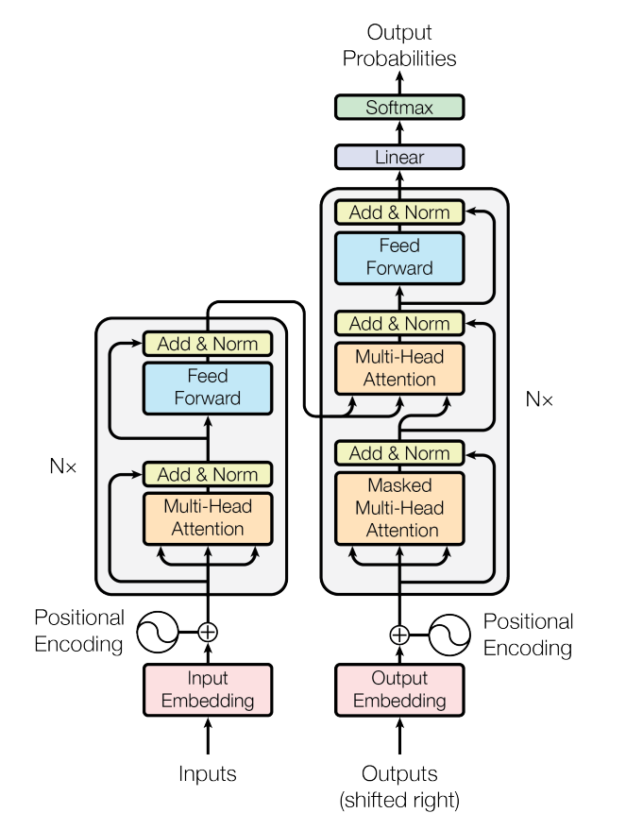
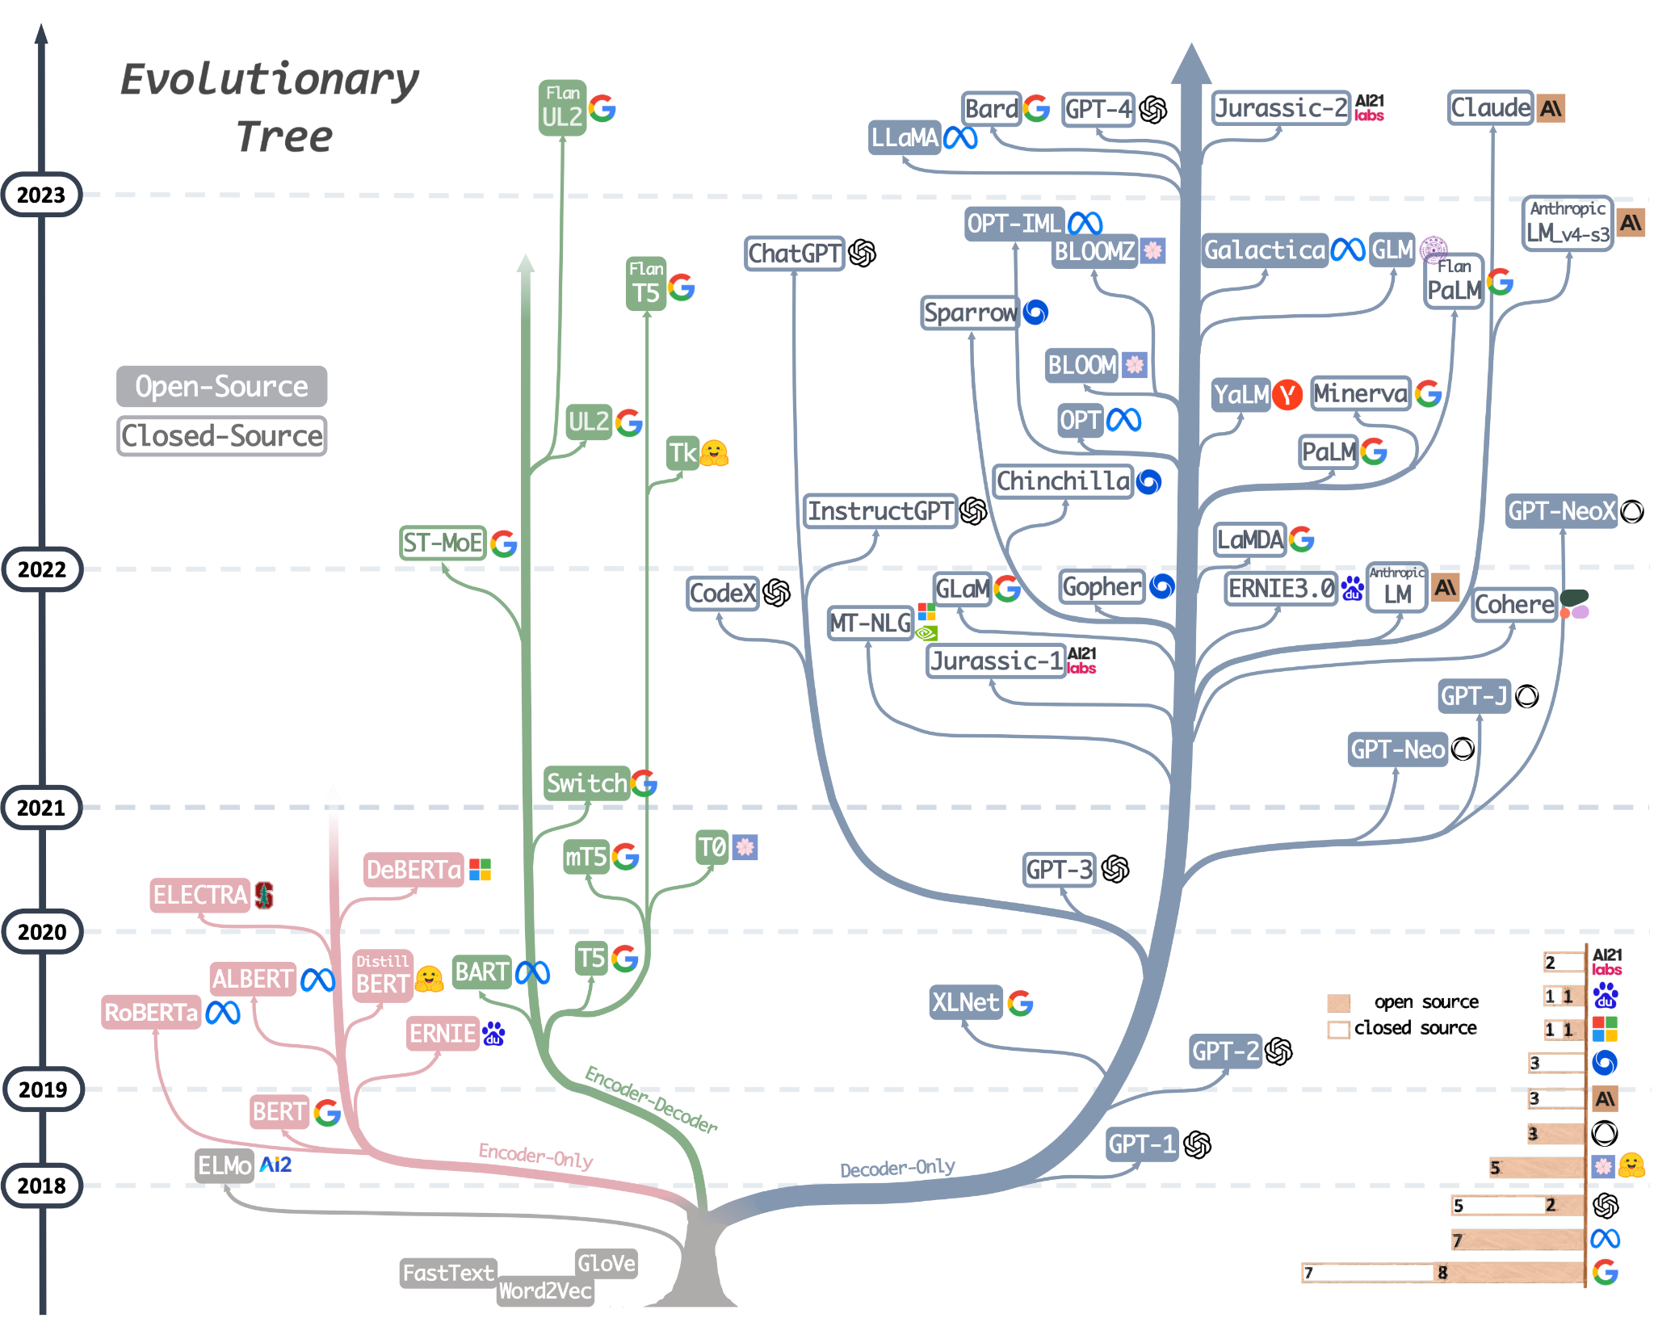
Ewolucja architektury
Źródło:
https://paperswithcode.com/method/linear-regresion
Notes:
A History of Generative AI: From GAN to GPT-4 - MarkTechPost
Mooler0410/LLMsPracticalGuide: A curated list of practical guide resources of LLMs (LLMs Tree, Examples, Papers) (github.com)
Transformer models: an introduction and catalog — 2023 Edition - AI, software, tech, and people, not in that order… by X (amatriain.net)

Slide 11
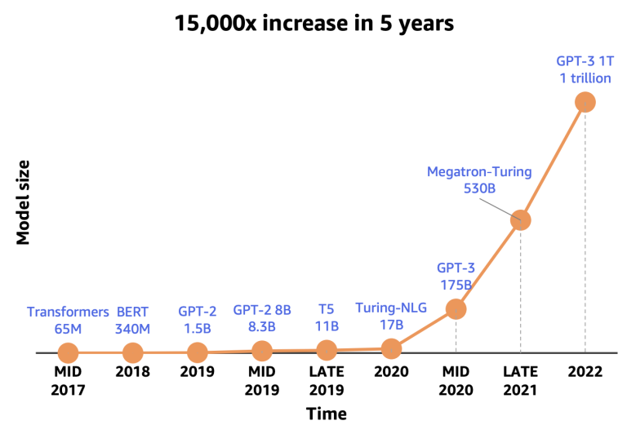
Zwiększenie rozmiaru modeli
Można w miarę precyzyjnie prognozować przyrosty jakości modelu
W coraz większych modelach występuje efekt ulepszeń-niespodzianek
Parametry, dane, czas treningu
Źródło:
https://paperswithcode.com/method/linear-regresion
Notes:
https://www.commonroom.io/blog/the-why-behind-large-language-models-with-ashish-bansal/
https://cmte.ieee.org/futuredirections/2023/04/24/how-much-bigger-can-should-llms-become/
https://neptune.ai/blog/nlp-models-infrastructure-cost-optimization
https://arxiv.org/abs/2304.00612
HPC: ChatGPT : the groundbreaking language model powered by HPC - The NCC Netherlands (eurocc-netherlands.nl) Counting The Cost Of Training Large Language Models (nextplatform.com)
NVIDIA AI Platform Delivers Big Gains for Large Language Models | NVIDIA Technical Blog How to Speed Up Training for Large Language Models | by Ng Wai Foong | Towards Data Science
https://bdtechtalks.com/2022/08/01/cerebras-large-language-models/
Inne:
Bag of Tricks for Training Data Extraction from Language Models (arxiv.org)

Slide 12
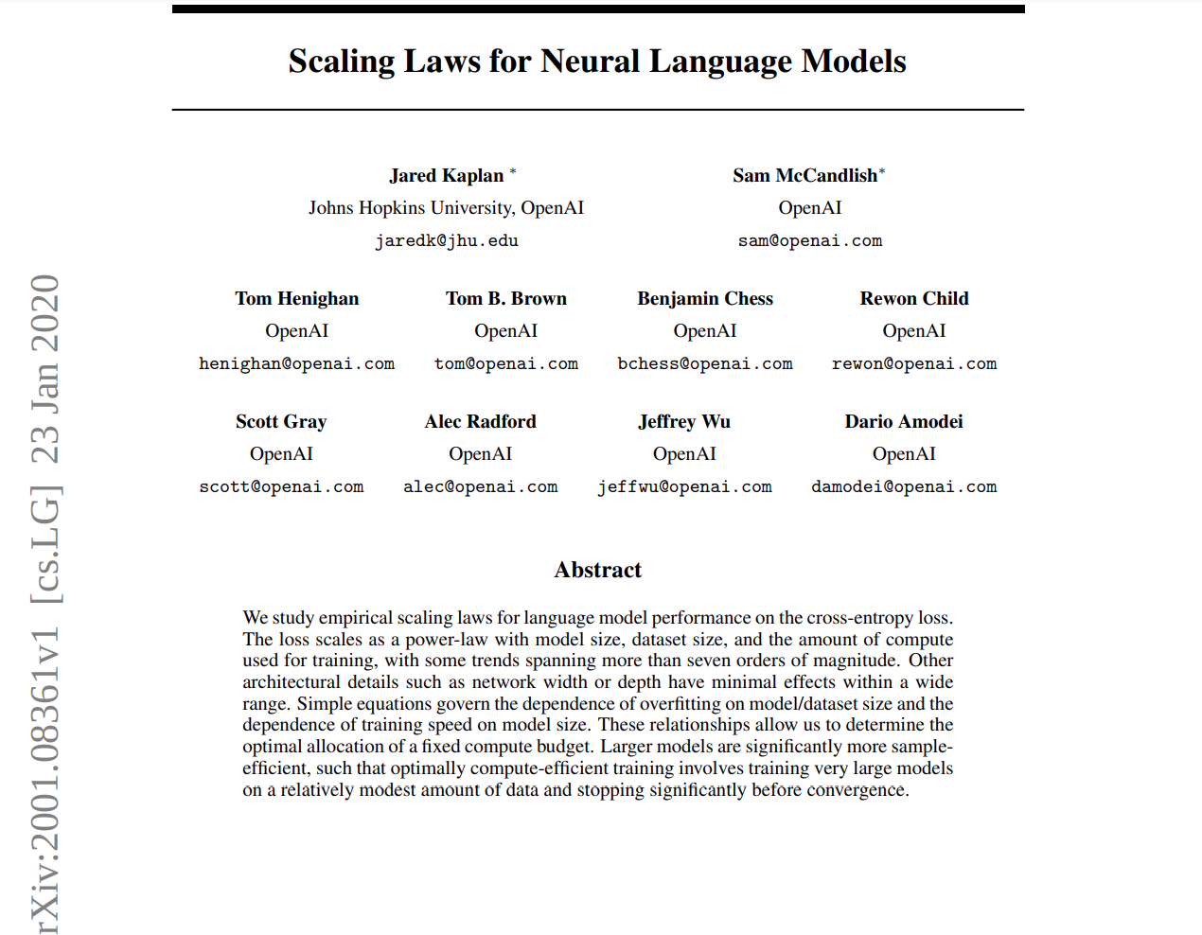
Scaling Laws for Neural Language Models
Źródło:
https://paperswithcode.com/method/linear-regresion
Notes:
https://medium.com/nlplanet/two-minutes-nlp-scaling-laws-for-neural-language-models-add6061aece7

Slide 13
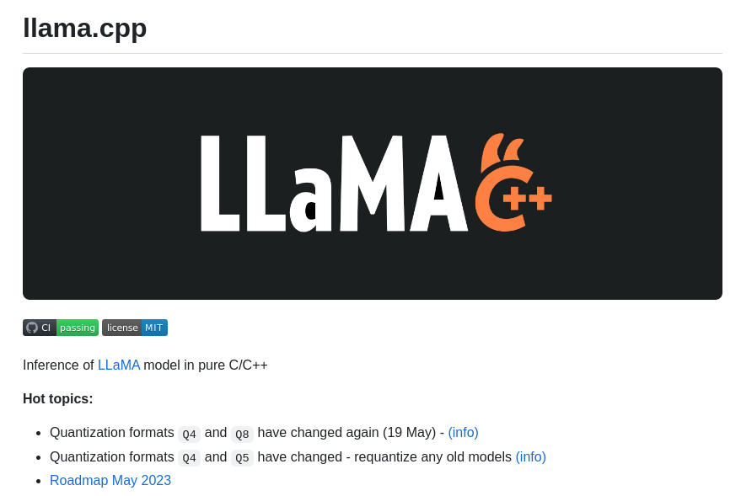
Trend - zmniejszanie modeli
Najpopularniejsze techniki:
Destylowanie wiedzy z większych modeli
Kwantyzacja większych modeli
Notes:
Zmniejszanie modeli:
https://spectrum.ieee.org/large-language-models-size
https://tinyml.substack.com/p/navigating-the-complexities-of-llm
https://sebastianraschka.com/blog/2023/llm-reading-list.html
https://medium.com/@bablulawrence/stanfords-alpaca-is-a-very-different-animal-c3c3abbd25fb

Slide 14
Dziękuję za uwagę!
Wykorzystano szablon prezentacji z:

